Slide 1
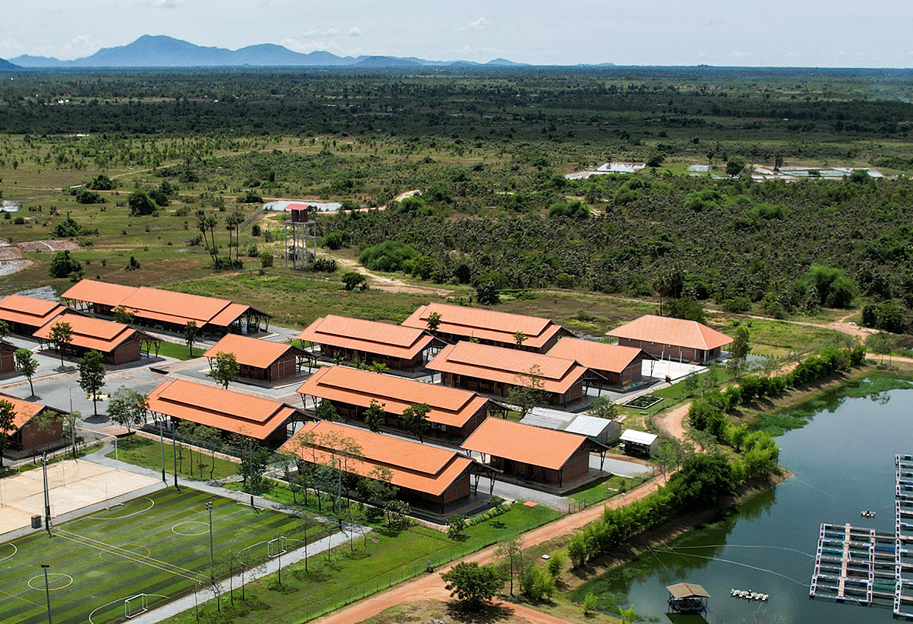





Driving Change Together
Matalan Retail is an ideal Corporate Fundraising Partner for Smiling Gecko, thanks to Matalan’s previous operations in Cambodia and extensive experience in empowering global communities
Benefits for Buro Happold
Alignment with key CSRD reporting metrics
Enhanced and elevated CSR campaigns
Tailored service offerings
Creation of social and sustainable impact
Smiling Gecko CSR
Initiative
2024

Slide 2
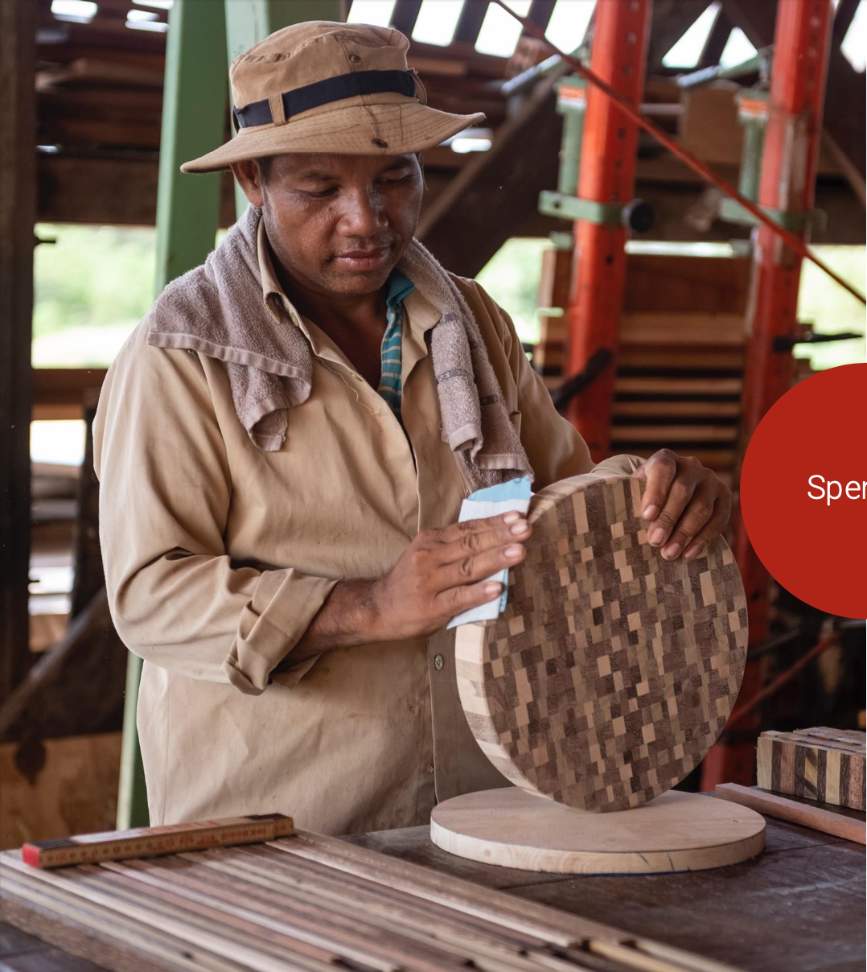





Enhance quality of life in rural Cambodia
Developing sustainable social enterprises
Delivering education and vocational training
Strengthening food security - organic farming, fish production, school meals
Fostering resilience and nationwide impact - cultural initiatives like "The Gong”
Purpose &
Vision

Slide 3
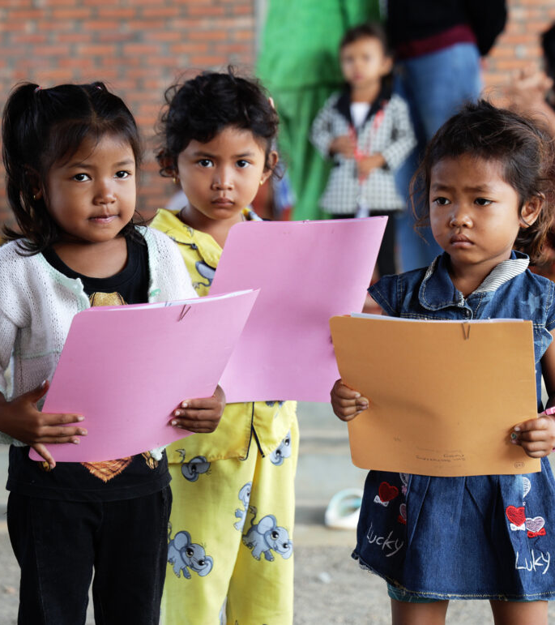

Economic
High poverty rates, with over one-third of Cambodians living on less than $2/day
Social
29% of 15-24-year-olds have not completed primary education in Cambodia
500’000 children in Cambodia grow up without their parents
The
Problem
Environmental
Unsustainable agricultural practices and biodiversity loss

Slide 4
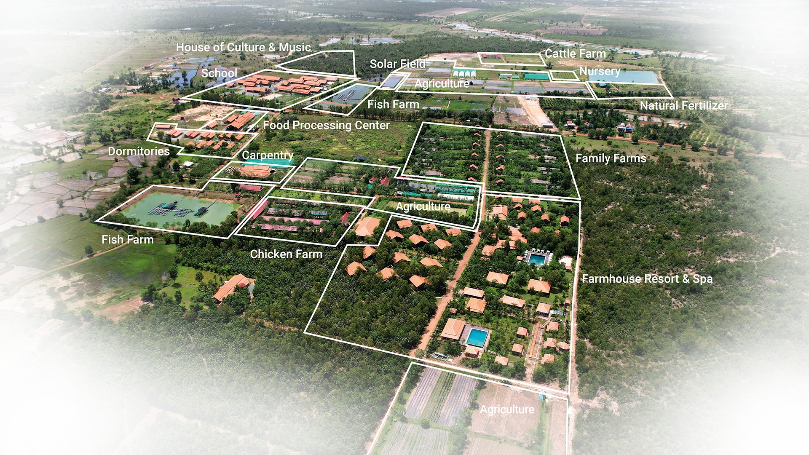




Smiling
Gecko
Campus
Craftsmanship & Production
Food Security & Sustainable Agriculture
Educational Development
Emergency Relief & Basic Needs
Community Development & Employment

Slide 5
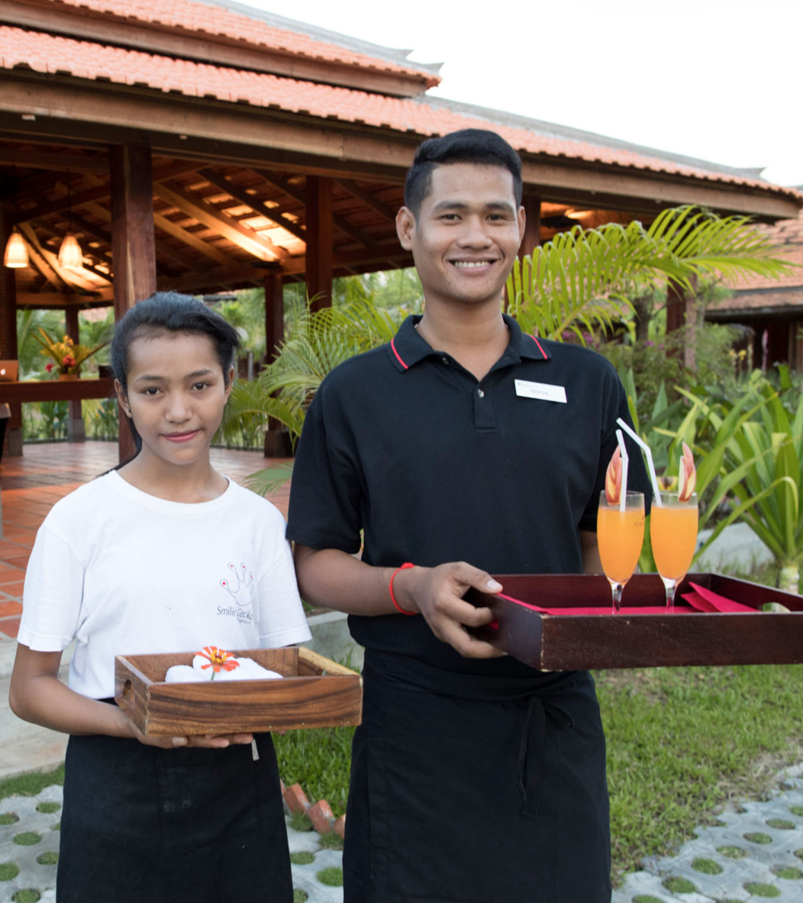



Project Farmhouse Resort
The Farmhouse Resort & Spa employs a total of 44 staff members and trainees in the area of gastronomy and hotel management and operates self-sufficient
Community Development & Employment
The Problem it resolves
Creation of employment and livelihood for local families | Raises awareness for visitors while making the impact of donors more tangible
Your
Impact
Funding need
5’000 $ commitment each year to train new staff

Slide 6

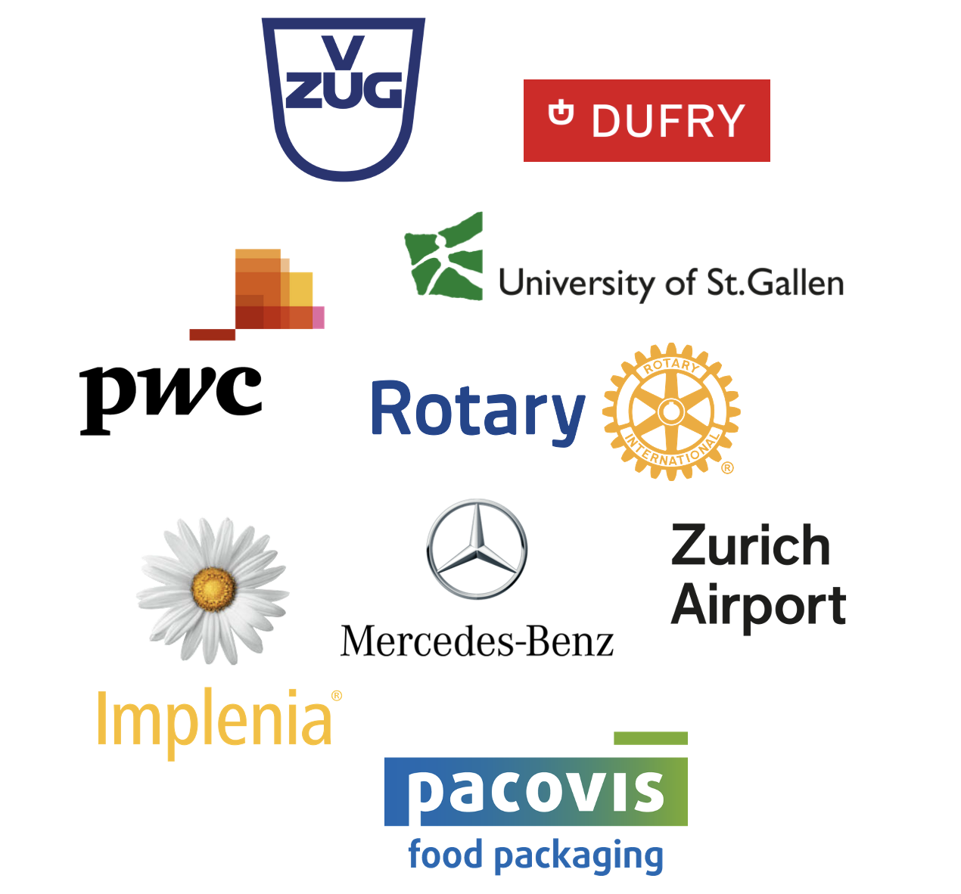
Organizations in Switzerland that have already successfully integrated Smiling Gecko into their CSR framework

Slide 7

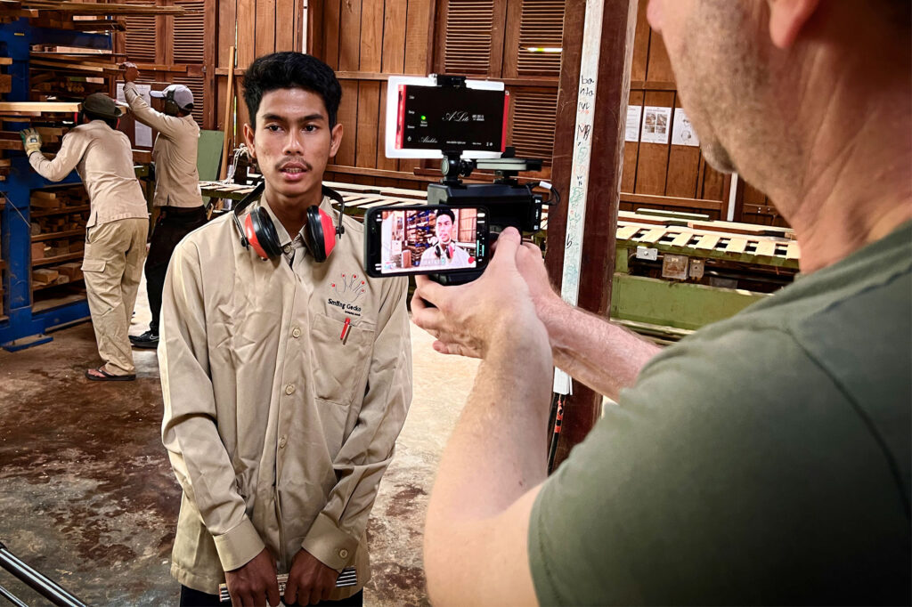
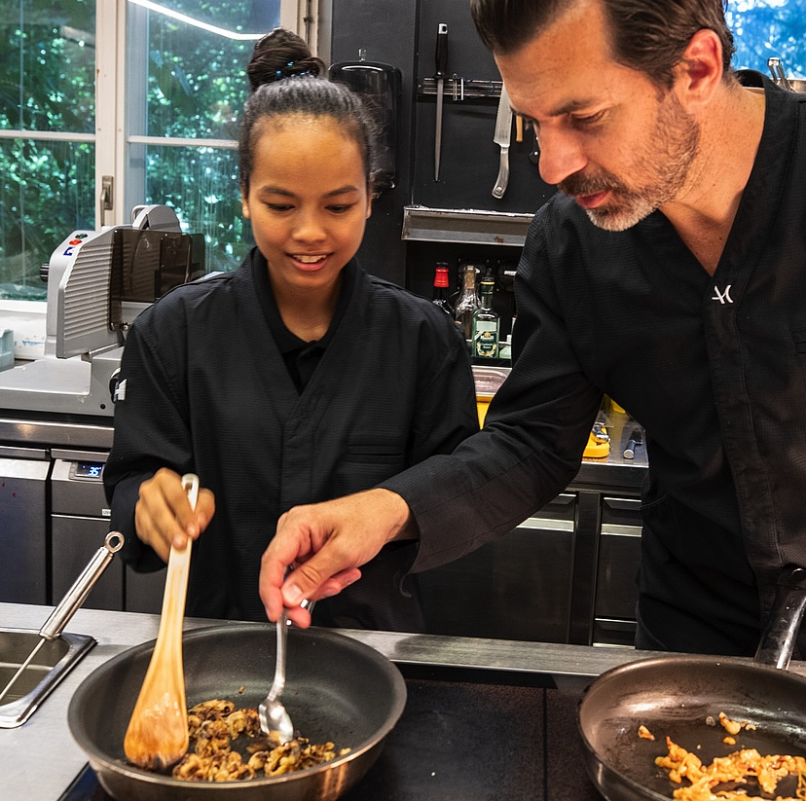
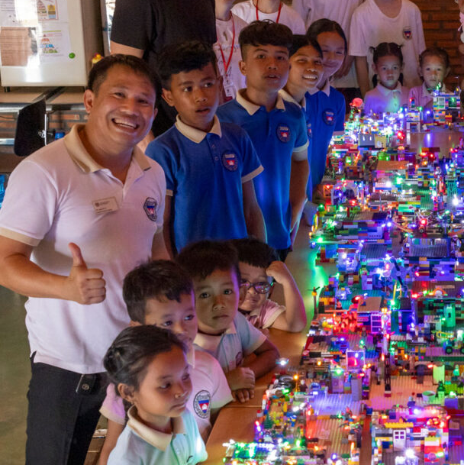

 | Monthly updated marketing material produced by an on-site video team in Cambodia
 | Interactive workshops (online and in UK), highlighting Smiling Gecko’s work and impact
 | Regular reporting with KPIs and progress updates (SDGs, CSRD reporting)
 | Visits to Smiling Gecko Campus, with full access to the resort’s amenities
If you want to help us,
We will help you

Slide 8
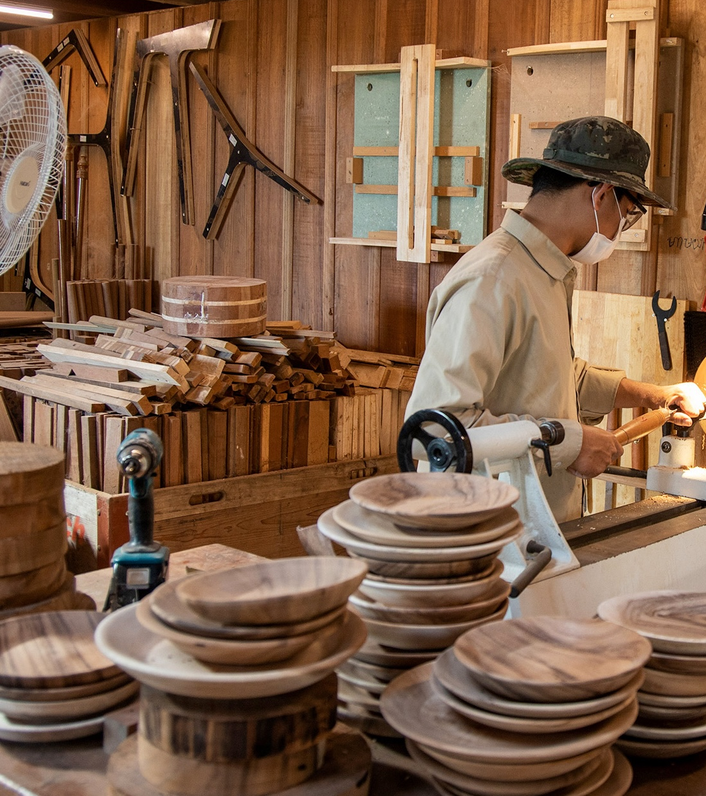

Self-Sufficieny
The aim is to create a circular economy that generates revenue for the entire community while:
Providing equal opportunities to bridge the inequality gap
Empowering communities through sustainable social enterprises
Attracting external investments to scale and replicate the model nationally
Smiling
Gecko
Model
1
NGO
2
Social Enterprise
3
Self-Sufficient Community

Slide 9
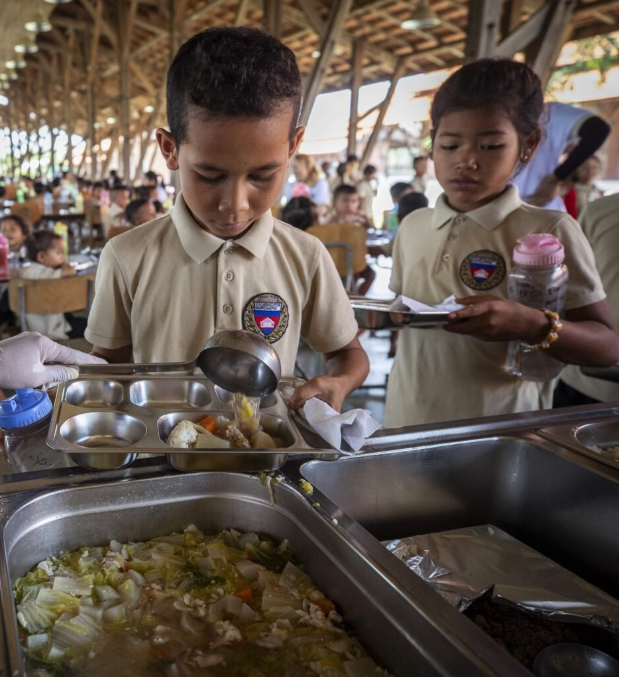

Building a Future for
Cambodia
520
children are going to school at the Smiling Gecko campus
50
more students every year are planned, ensuring continuous growth and opportunities
Innovative initiatives like the Farmhouse have already achieved self-sufficiency, paving the way for sustainable progress and empowerment
Evidence of
Success

Slide 10
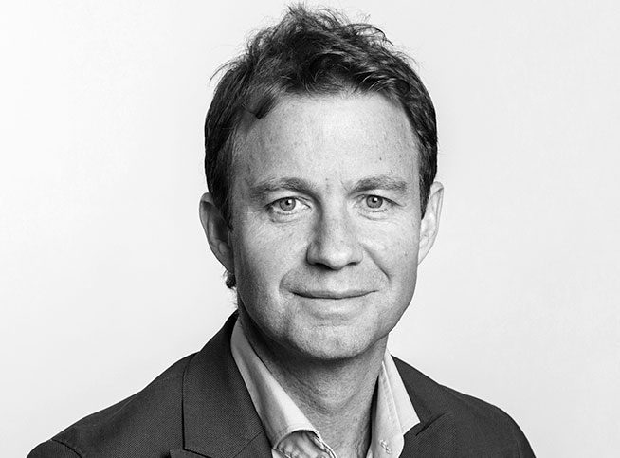
Your Contact at Smiling Gecko
Alain Biner
Telefon: +41 44 321 67 70
E-Mail: biner@smilinggecko.ch

